Slide 1




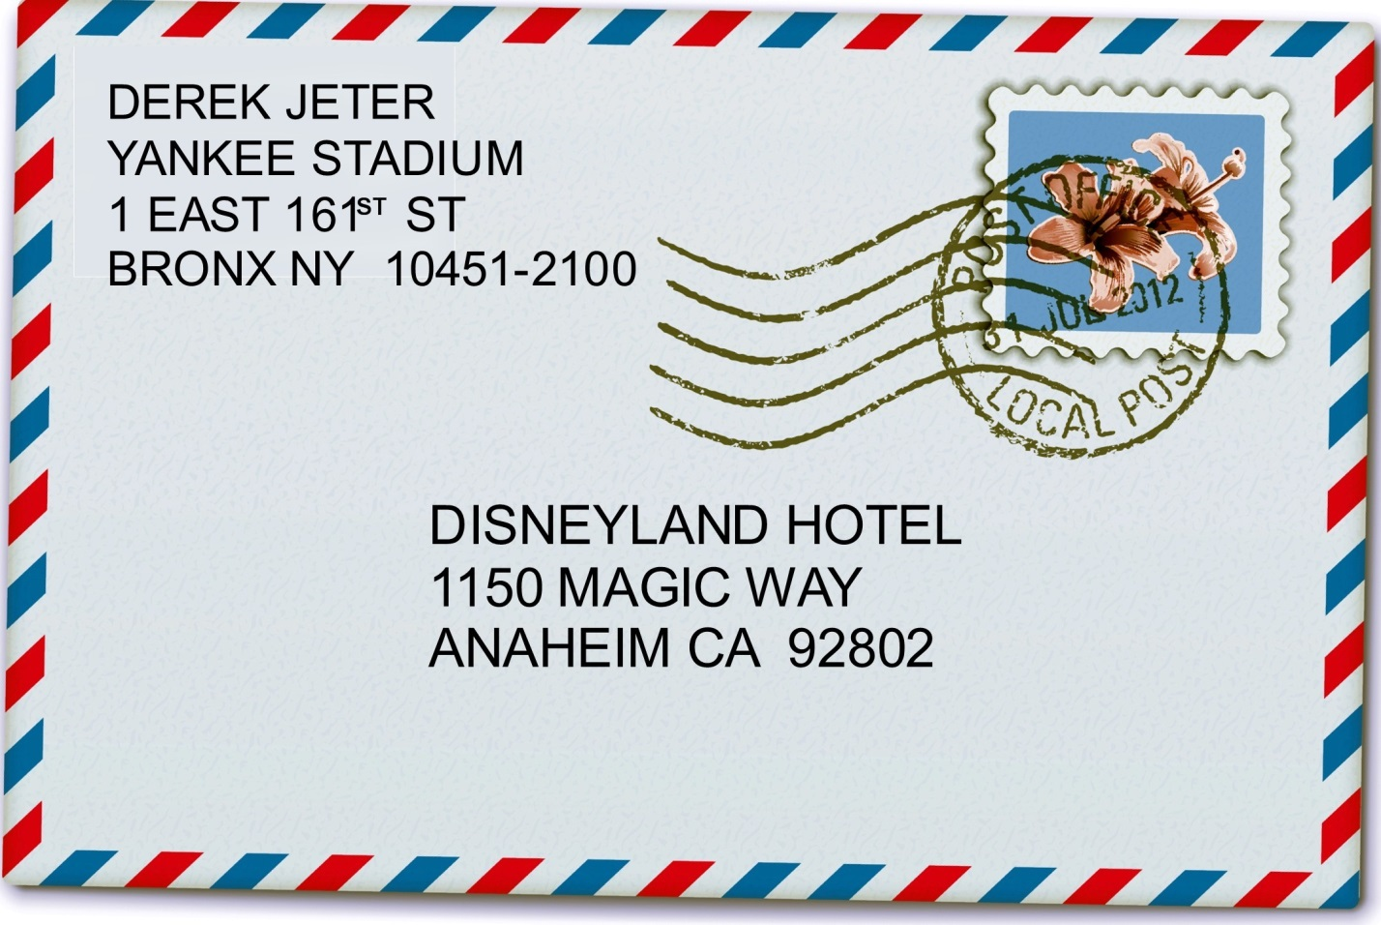
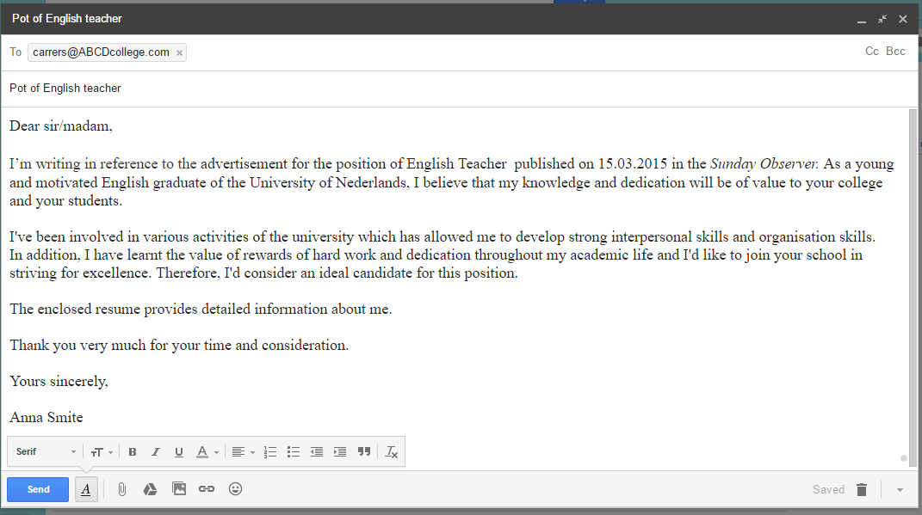

Slide 2

Formal letters/emails
Our aim:
to learn how to write formal letters or emails of different types

Slide 3

Formal letter: structure

Slide 4
Ex.1, p. 128
Answer keys
Formal letters/emails | Informal letters/emails
A (a course director), D (a hotel owner), F (the organiser of an event), G (a visiting speaker) | B (your friend), C (your aunt), E 9your friend)

Slide 5

Ex.2, p. 128
Answer keys
1 ending
2 beginning
3 beginning
4 ending
5 beginning
6 ending
7 ending
8 beginning
1,3 G 2,6 F 7,8 A

Slide 6
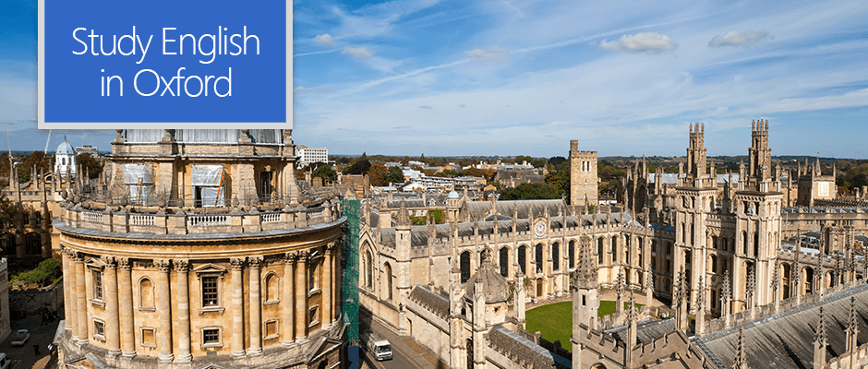
Read the rubric and underline the key words:
You have seen an advert for a summer English course in Oxford, England. Use the notes you have made to write an email to the course director asking for more information (120-180 words).

